Slide 1
MORSE CODE GENERATOR
A COLLABORATED EFFORT OF
SATWIK KAMATH 1ms21ec098
Shreesha T P 1ms21ec102
Shreeya r 1ms21ec103
Shreya p Manchala 1ms21ec105
3RD SEMESTER ECE, SECTION ‘C’

Slide 2
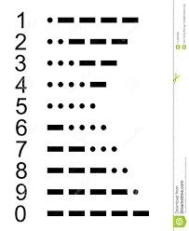
What is Morse code?
Morse code refers to a method of communication that uses a series of dots and dashes to relay information.
Here, dots and dashes are arranged in a series of specific patterns. Each pattern represents a letter of the alphabet or number.
Morse code is named after Samuel Morse, one of the inventors of the telegraph.

Slide 3
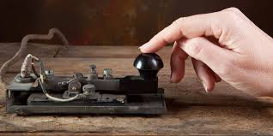
Why morse code??
Morse code is an efficient way to communicate about emergency situations
you can send such messages via ham radio transmitters with little power and less bandwidth.

Slide 4
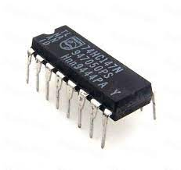
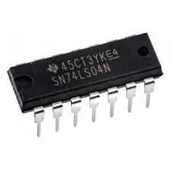
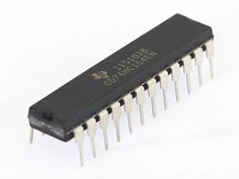
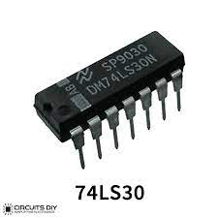
List of components used
IC 74147 10 TO 4 ENCODER
IC 7404 NOT GATE
IC 74154 4 TO 16 DECODER
IC 74LS30A 8-INPUT NAND GATE

Slide 5
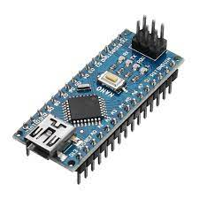
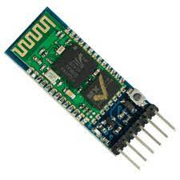
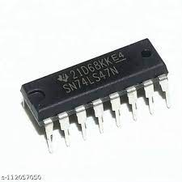
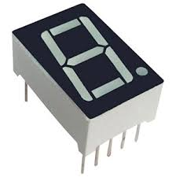
Arduino Nano
HC 05 Bluetooth Module
IC 7447 BCD to Seven segment Decoder
Seven Segment Display

Slide 6
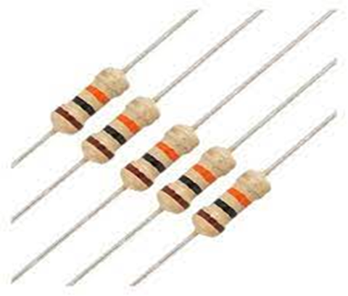
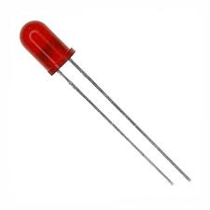
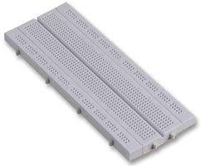
330 Ohm Resistors
LEDs
Breadboard

Slide 7

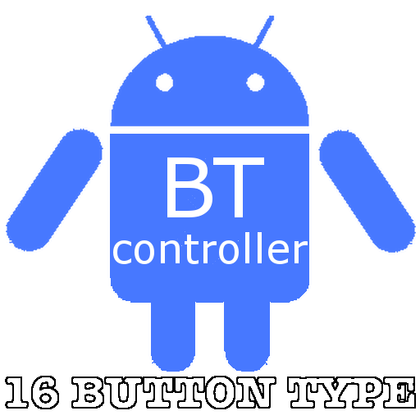
SOFTWARES USED
Arduino IDE
Bluetooth Serial Controller

Slide 8
WORKFLOW
APP
DECODER
OUTPUT LEDS
ENCODER
MICRO CONTROLLER

Slide 9
WORKFLOW
ENCODER
BCD DECODER
SEVEN SEGMENT
DISPLAY

Slide 10
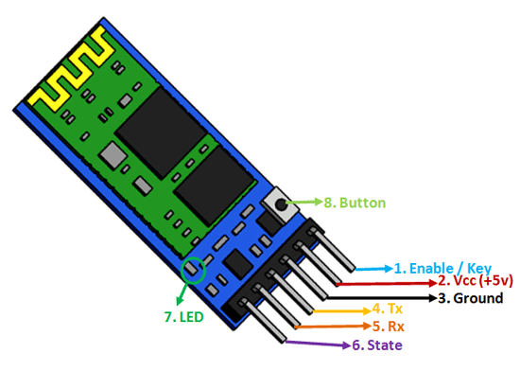
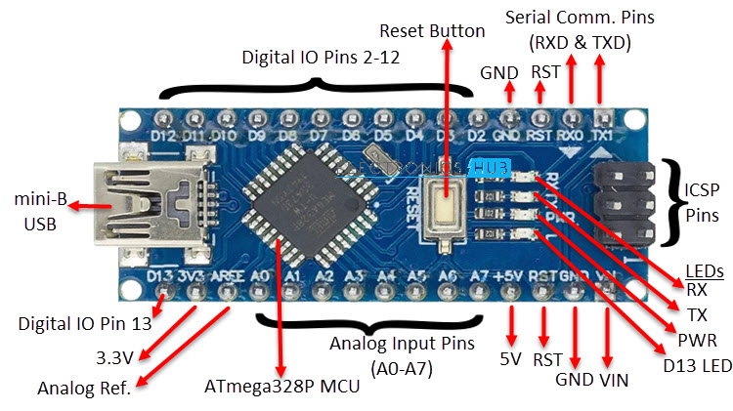
STAGE 1
The user selects a number from 0 to 9 through the App.
This data is transferred to the 10 to 4 PRIORITY ENCODER using an Arduino Nano and Bluetooth module(HC 05)

Slide 11
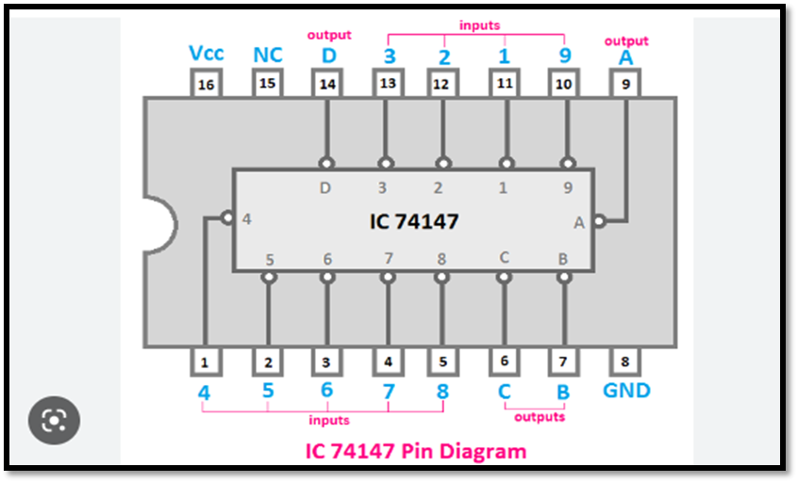
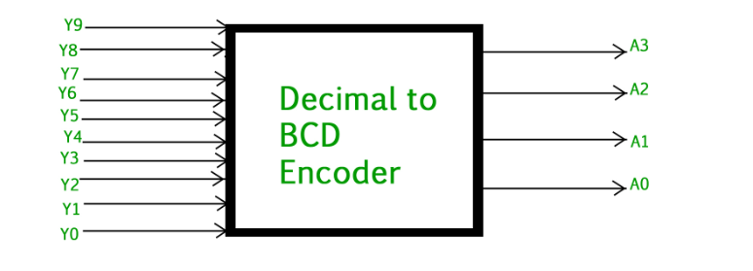
STAGE 2
The 10X4 Priority encoder converts decimal input into binary
Not gates are used to complement the output (active low encoder)

Slide 12
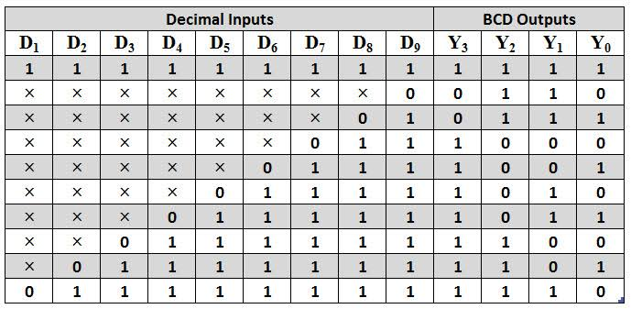
TRUTH TABLE OF Decimal to binary encoder

Slide 13
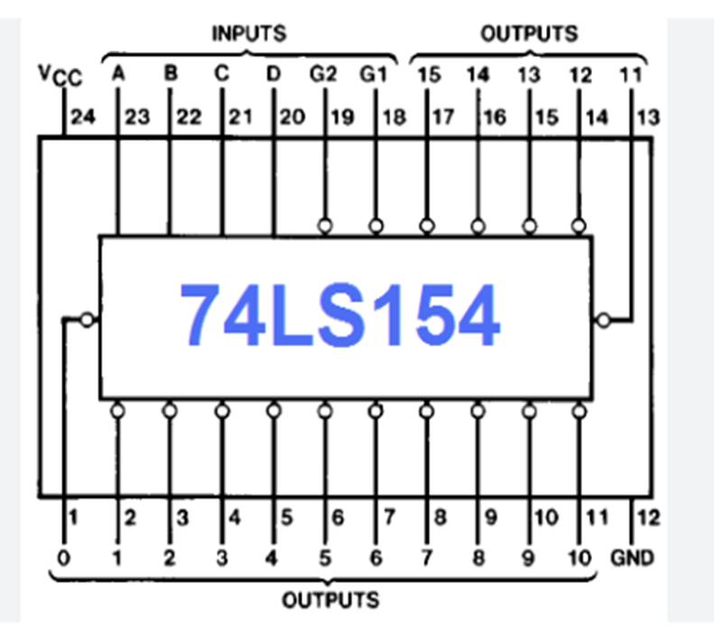
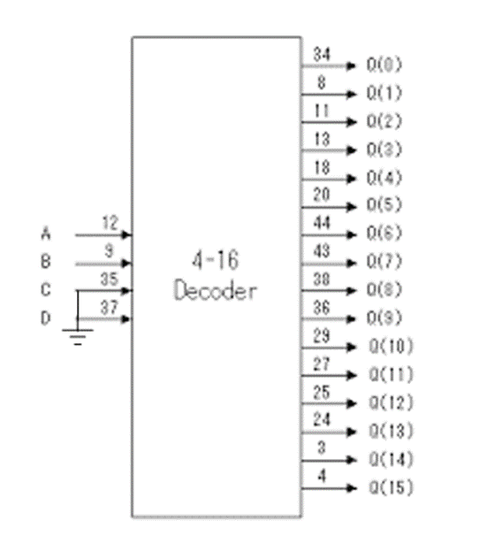
PIN DETAILS AND BLOCK DIAGRAMS

Slide 14
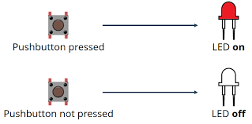
STAGE 3
The binary number is the input to the 4X16 DECODER
The LEDS glow indicating the resulting Morse code
The LED ON indicates DOT
THE LED OFF indicates DASH
For example , the output for number 1 would be
00 111 , i.e. Dot Dot Dash Dash Dash

Slide 15
MORSE CODE DESIGN
LED 1
IC 74154
(4X16)
IC 74LS30A
A
LED 2
B
C
LED3
D
EN
EN
LED4
LED 5

Slide 16
TRUTH TABLE OF THE DECODER
Binary Inputs |  |  |  | Morse Outputs
A3 | A2 | A1 | A0 | L5 | L4 | L3 | L2 | L1
0 | 0 | 0 | 0 | 1 | 0 | 0 | 0 | 0
0 | 0 | 0 | 1 | 1 | 1 | 0 | 0 | 0
0 | 0 | 1 | 0 | 1 | 1 | 1 | 0 | 0
0 | 0 | 1 | 1 | 1 | 1 | 1 | 1 | 0
0 | 1 | 0 | 0 | 1 | 1 | 1 | 1 | 1
0 | 1 | 0 | 1 | 0 | 1 | 1 | 1 | 1
0 | 1 | 1 | 0 | 0 | 0 | 1 | 1 | 1
0 | 1 | 1 | 1 | 0 | 0 | 0 | 1 | 1
1 | 0 | 0 | 0 | 0 | 0 | 0 | 0 | 1
1 | 0 | 0 | 1 | 0 | 0 | 0 | 0 | 0

Slide 17
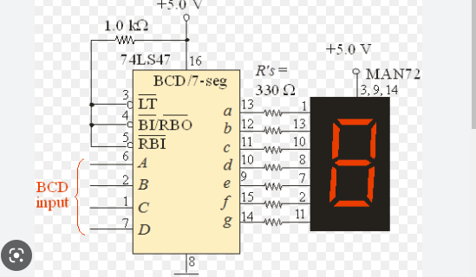
STAGE 4
The output from the encoder is fed into the BCD to seven segment integrated circuit
The result is obtained on the seven segment display

Slide 18
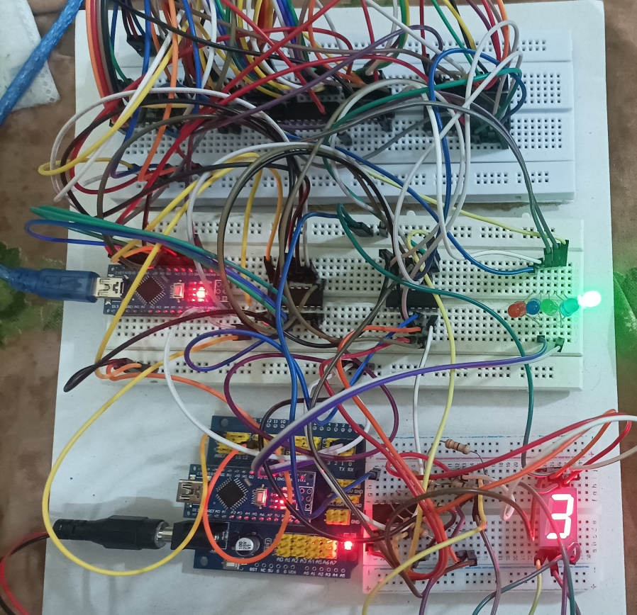
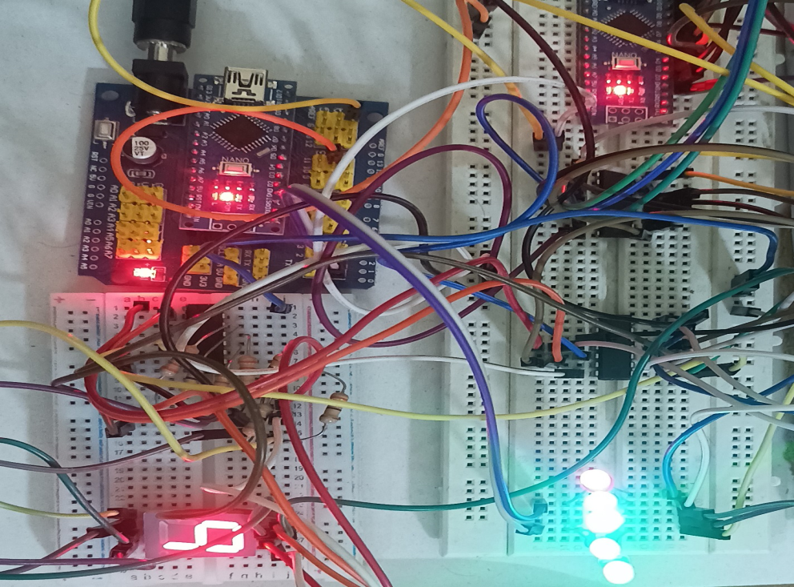
Few snippets

Slide 19
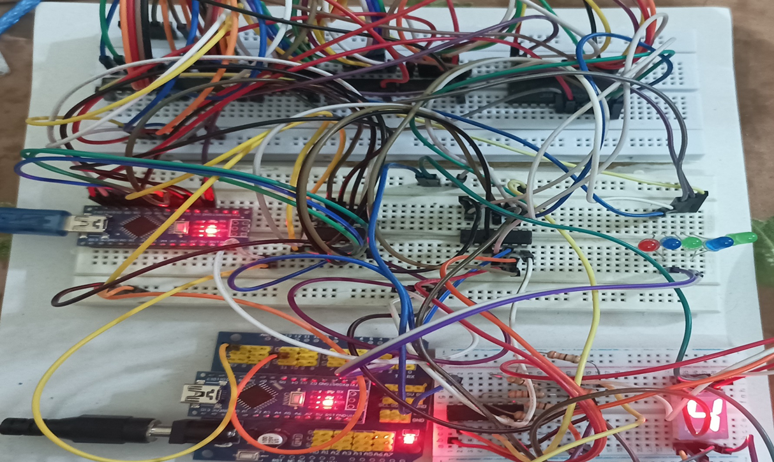

Slide 20
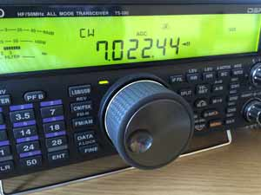
WHERE is this USED??
Radio communication
It is mainly used by radio operators to communicate with each other and also used to distinguish from spark transmission from radio transmission.

Slide 21
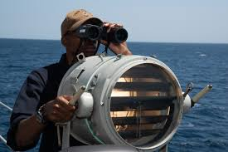
In defence…
The military first used Morse code during the Crimean War. Both the Union and Confederate armies heavily relied on Morse code during the Civil War.
It is still used heavily by the Navy to communicate between ships with lights because it is jam-proof, works under a variety of weather conditions, can work over several miles of distance

Slide 22
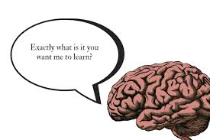
It’s a fun brain teaser!!
Survey said that Learning Morse Code alters Microstructural Properties in the brain and increases neuroplasticity, which is the brain's ability to reorganize itself by forming new neural connections throughout life.

Slide 23
Thank You
- .... .- -. -.- -.-- --- ..-

